Slide 1
Comprehensive Digital Marketing Project Work

Slide 2
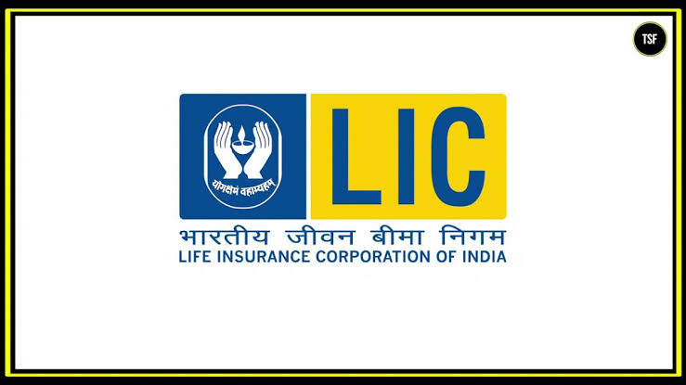
Life Insurance corporation of India

Slide 3

TEAM MEMBERS:
Keerthika Kuppili(Team leader)
Lalam Chandini
Malakot Awshin Krishna
Majji Saketh
Lagudu Sai Likitha

Slide 4
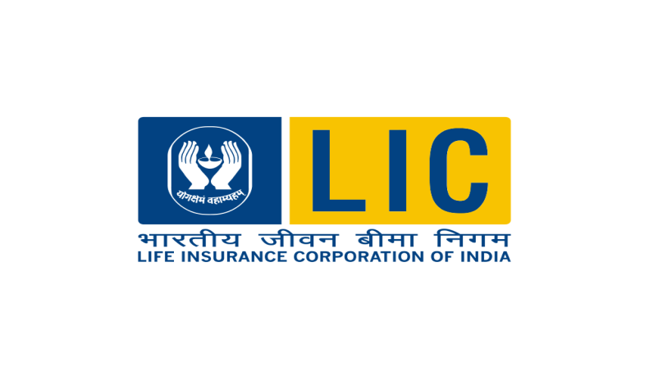
Part 1: Brand study, Competitor Analysis & Buyer’s/Audience’s Persona
Research Brand Identity: Study the brand's mission, values, vision, and unique selling propositions (USPs).
Introduction: . It is an insurance company with 8 zonal offices and 101 divisional offices with its headquarters located in Mumbai. Besides giving life insurance, LIC also offers mutual funds, health insurance, and investment management services. LIC International, LIC Nepal, LIC Lanka, and LIC Housing Finance are all subsidiaries of India’s life insurance firms.LIC offers a very vast and huge range of diversified products catering to the needs of various sections of people in India and outside of India. It offers individual solutions considering their specific financial requirement and risk profile and helps to solve it.
Brand website: https://licindia.in/

Slide 5
Mission/Values: Our Mission is to “Ensure and enhance the quality of life of people through financial security by providing products and services of aspired attributes with competitive returns, and by rendering resources for economic development.”
Values:
Caring & Courtesy
Initiatives & innovation
Integrity & Transparency
Quality & Returns
Participation & Relationship
Trustworthiness & Reliability
USP:LIC is governed by a distinct 1956 parliamentary act rather than the law that governs the nation's other insurance firms. LIC enjoys a sovereign guarantee of its policies, giving it a unique selling point and allowing it to operate with a thinner capital base than its competitors

Slide 6
Analyze Brand Messaging: LIC communicated the message strongly in its popular ‘Roti, Kapda, MakanaurJeevanBima’ (Food, Clothes, Shelter and Life Insurance) ad series in the 80s on Doordarshan. LIC also relied on print ads, outdoor and word-of-mouth to spread the message.
LIC remains one of the largest users of outdoor, says Sashidharan Nair, senior partner, RKSwamy/BBDO, which has managed the LIC advertising account for the last 20 years. “You can see it everywhere. The idea is to reach as many people as possible,” he says.
Examine the brand's tagline: The Tagline of LIC is YogakshemamVahamyaham which means “Your welfare is our responsibility”. On the symbolical level, the meaning of the LIC logo is relatively straightforward. The two hands symbolize protection, while the flame represents what is protected.

Slide 7

Competitor Analysis: Select three competitors operating in the same industry or niche as the chosen brand, examine their USPs and online communication.
Competitor analysis: Analyzing the three competitors operating in the same industry or niche as the chosen brand examining their USP and online communication.
Competitor 1:SBI Life Insurance:
Website: click here
Part 1: Brand study, Competitor Analysis & Buyer’s/Audience’s Persona

Slide 8

USP: SBI Life Insurance has to choose, who are the customers that it can best serve based on its resources and capabilities SBI Life Insurance has to choose, who are the customers that it can best serve based on its resources and capabilities.
ONLINE COMMUNICATION : They reach their customers through website, where they give their contact so that the customers can reach them . The company reaches them through calls and messages from social media like whatsapp 8once they get details from the website or from the other sources. They let know the policies, discounts and different schemes.
COMPETITOR 2: Sahara Life Insurance
Website: click here

Slide 9
USP: All the objectives of buying a life insurance plan are taken care of with a potential of earning higher returns over the term of the policy. The unit linked plan enhances the value of the savings over a period of time and offers choices to the customers to choose the investment plan according to their risk profile and investment horizon at various points during the life of the policy.
ONLINE COMMUNICATION: They reach their customers through website, where they give their contact so that the customers can reach them . The company reaches them through calls and messages from social media like WhatsApp once they get details from the website or from the other sources. They let know the policies, discounts and different schemes

Slide 10
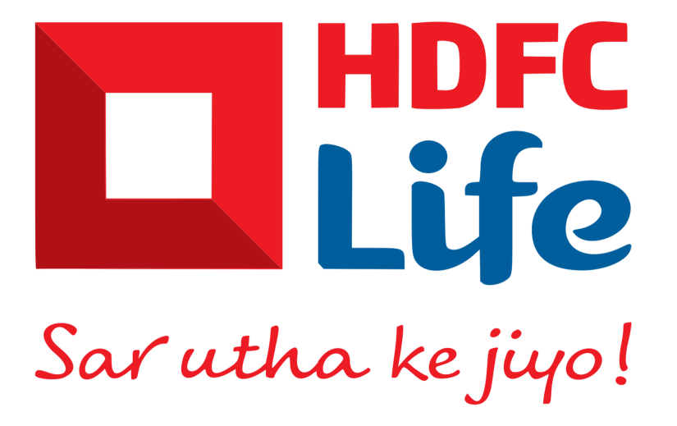
COMPETITOR 3: HDFC Standard Life
Website: click here
USP: It Has Low Premiums: HDFC Life Term Insurance has some of the lowest premiums in the market. This makes it an affordable option for people who want to buy life insurance. 3. It Has Flexible Terms: HDFC Life Term Insurance offers flexible terms that allow policyholders to choose the tenure of their policy.
ONLINE COMMUNICATION: HDFC reach their customers through website, where they give their contact so that the customers can reach them . The company reaches them through calls and messages from social media like WhatsApp once they get details from the website or from the other sources. They let know the policies, discounts and different schemes

Slide 11
Part 1: Brand study, Competitor Analysis & Buyer’s/Audience’s Persona
Buyer's/Audience's Persona: Clearly define the target audience for the chosen brand. Consider demographics, psychographics, behaviors, and interests
CHILDERN : LIC JeevanTarun Plan is a participating non-linked limited premium payment plan. This LIC money-back plan offers an attractive combination of protection and saving features for children. This LIC plan for kids is designed in such a way that it meets their educational and other financial needs while they are growing up.
YOUTH AND ELDERS: LIC Jeevan Azad policy is 90 days and the maximum is 50 years. The maturity age is a minimum of 18 years and a maximum of 70 years. The Premium Payment Term (PPT) under this Limited Premium Endowment plan is equal to the Policy Term minus 8 years. This means that if a policy is purchased for 20 years, the premium will only be paid for 12 of those years. Similarly to that, a person will pay premiums for a policy term of 18 years for 10 years. It offers a guaranteed base sum-assured amount for the living life insured on the day of maturity.

Slide 12

FAMILY: LIC policies that focus on the financially poor citizens is the Aam Aadmi Bima Yojana. It is a social security scheme launched by LIC on October 2, 2007, that aims to provide financial coverage to low-income families in India

Slide 13
Part 2: SEO & Keyword Research
SEO Audit: Do an SEO audit of the brands website.
Keyword Research: Define Research Objectives, Brainstorm Seed Keywords, Utilize Keyword Research Tools (SEMrush or Moz Keyword Explorer),Analyze Competitor Keywords, Long-tail Keyword Exploration (specific, longer phrases) that align with the research objectives and have lower competition but higher conversion potential.
On page Optimization: Meta Tag optimization & content optimization. Reflect on the process of conducting keyword research and the SEO recommendations provided.
Document the challenges faced during the research and analysis phase, as well as the key insights gained from the keyword research process.

Slide 14
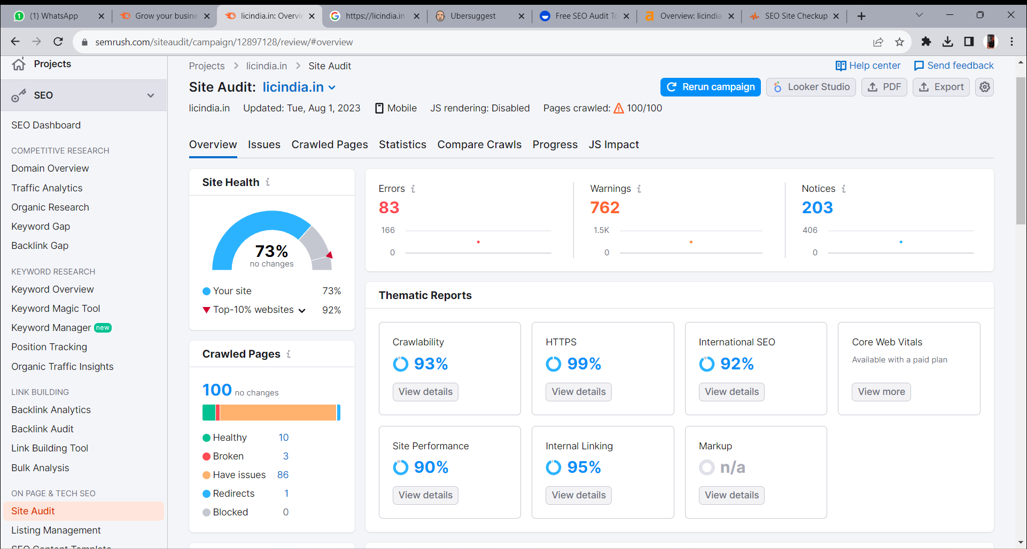
A. SEO AUDIT
Website: https://www.semrush.com/

Slide 15
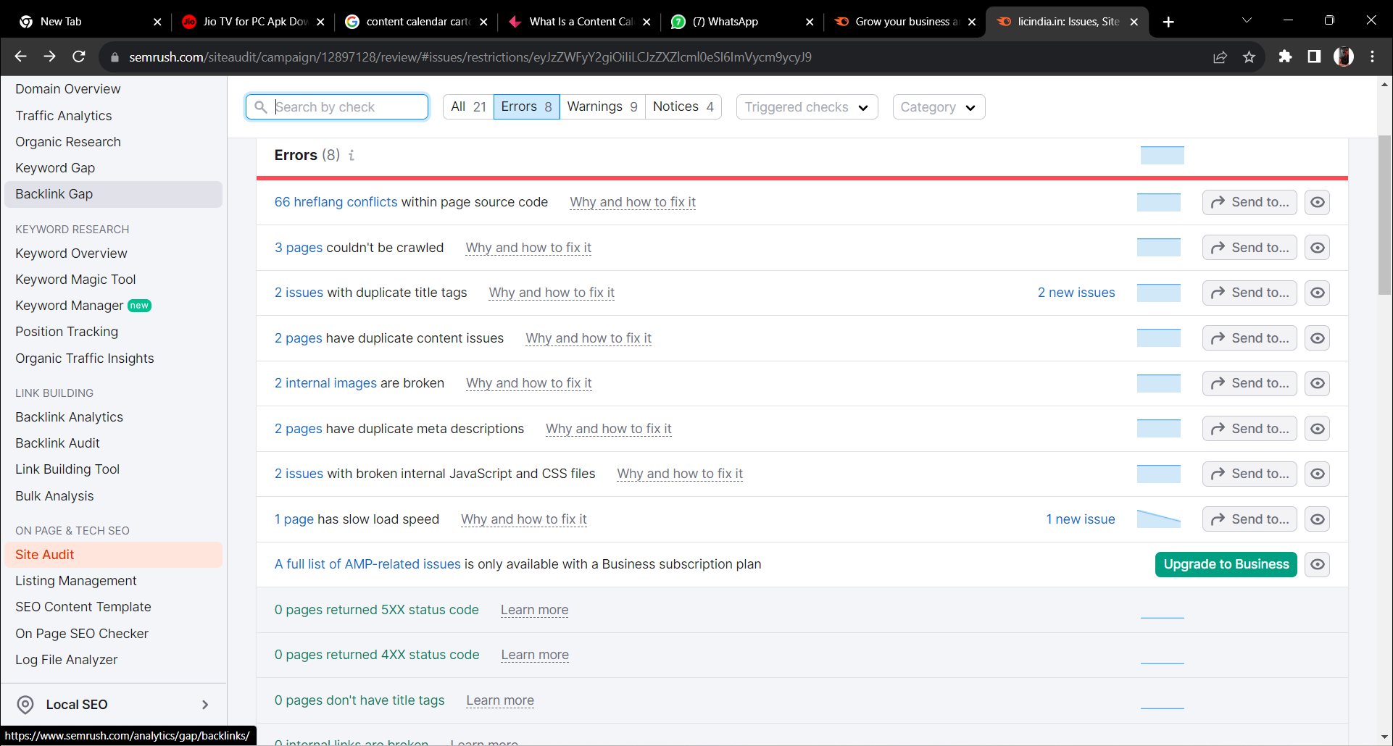
SEO Audit summary:
The site audit for LIC(www.licinida.in) indicates that the site’s health rate is 73%, which has remained unchanged. The Crawlability and HTTPS implementation of the website are at a commendable 93% and 99% ensuring smooth accessibility and security. The site performance scored 90% and internal linking scored 95%. The international SEO is at a tremendous range of 92%
We can find out 83 errors and 762 warnings which requires more attention. Furthermore, the company LIC is currently having 203 notices inbox.

Slide 16
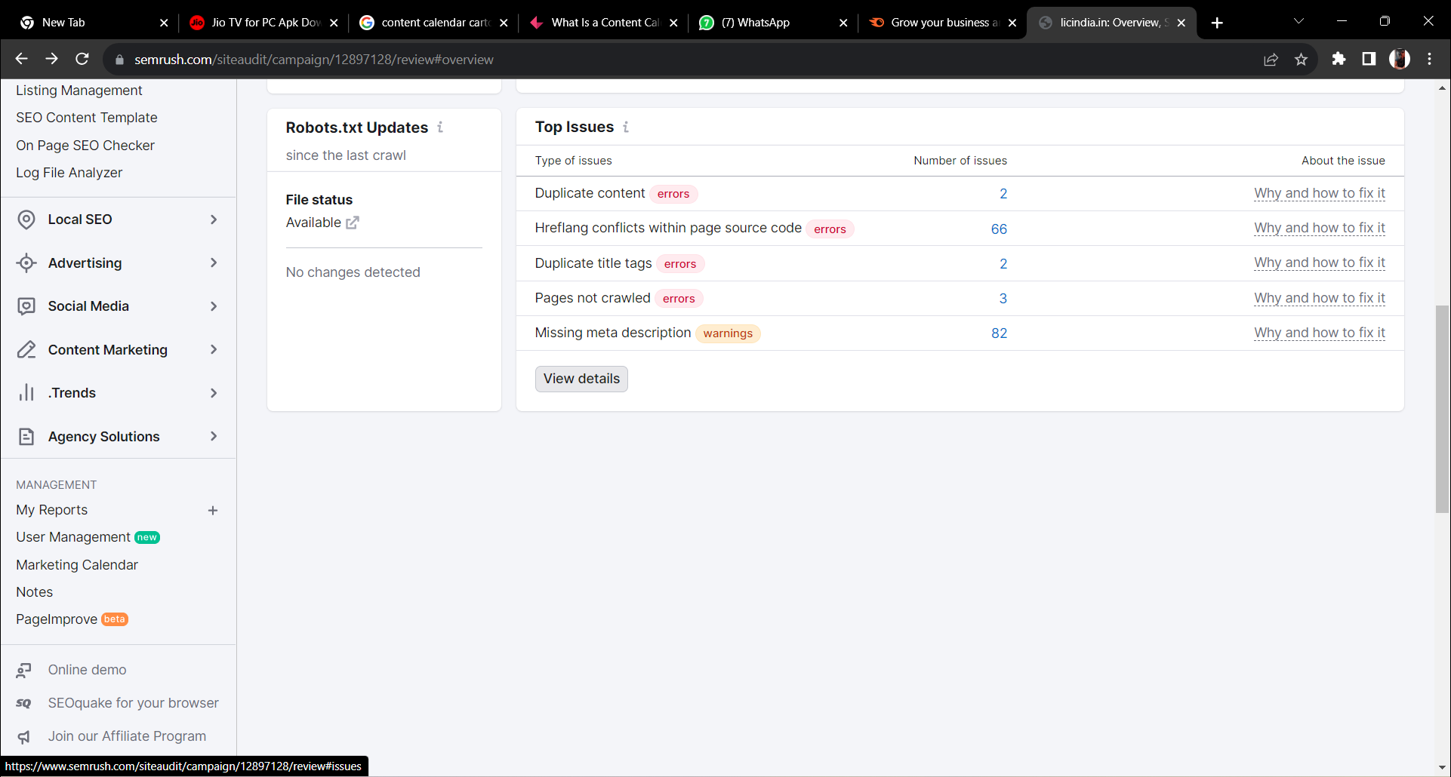
The above picture shows the top issues of LIC company. The above picture states that the major issue is missing Meta description at 82% and the conflicts within page source code errors at 66%. This page also contains 2 duplicate content and also to duplicate title tags.

Slide 17

B.KEYWORD RESEARCH
WEBSITES: 1.https://www.semrush.com/ (Semrush)
2.https://neilpatel.com/ubersuggest/ (Ubersuggest)
Objectives of LIC to do keyword research:
Understanding customer intent
Improving search Engine visibility
Targeting audiences
Competitor analysis
Content planning and Creation
Pay-per-click Advertising
Optimizing web Navigation

Slide 18
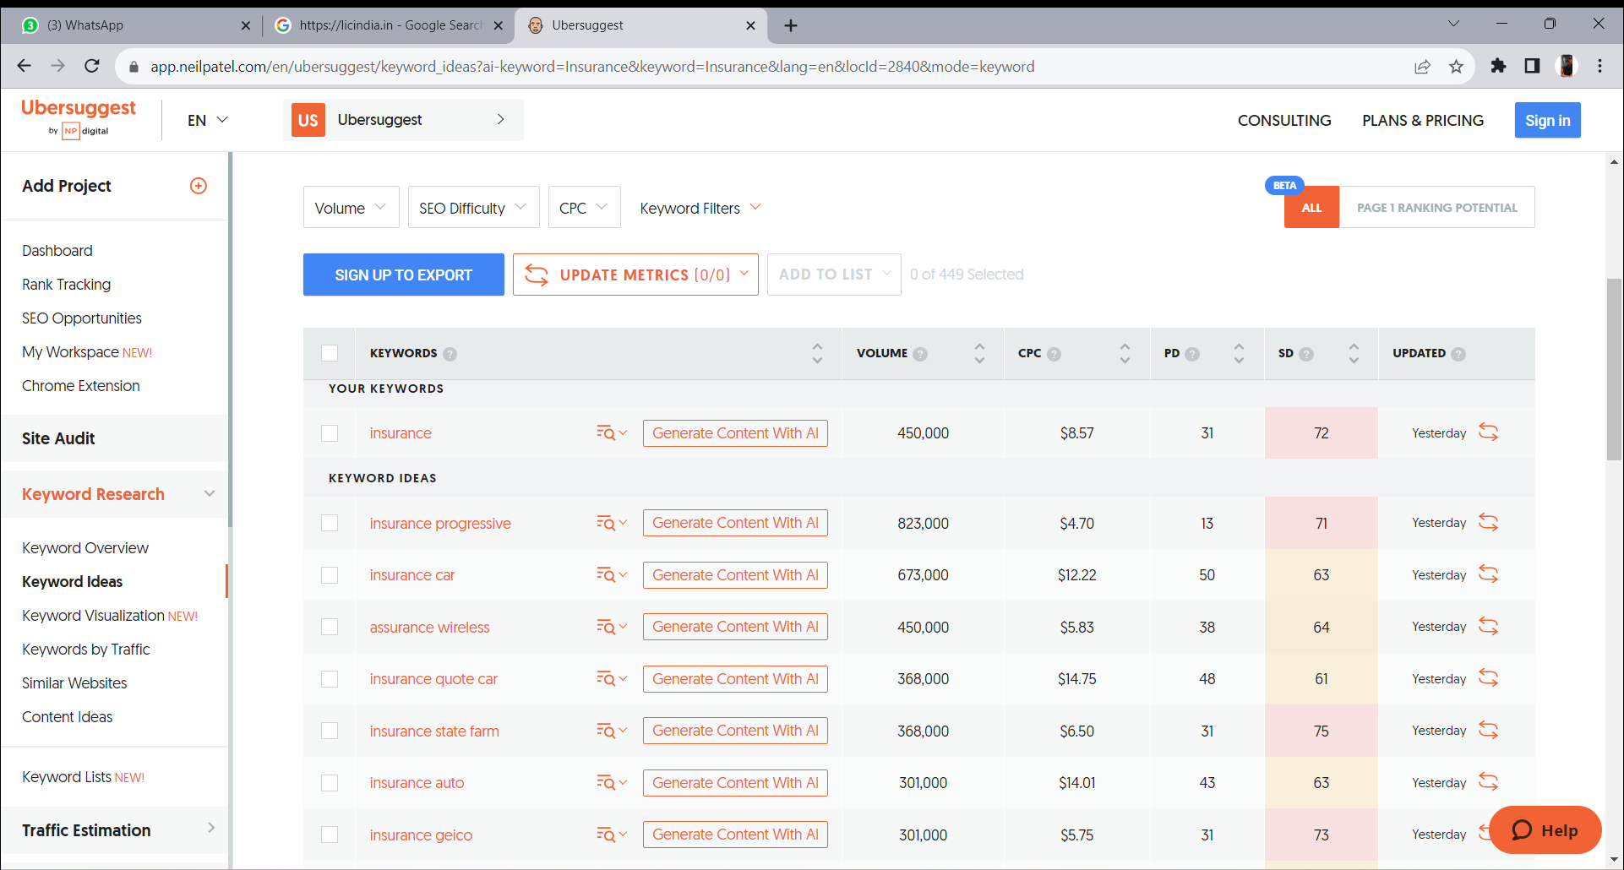
TOP KEYWORDS OF LIC

Slide 19
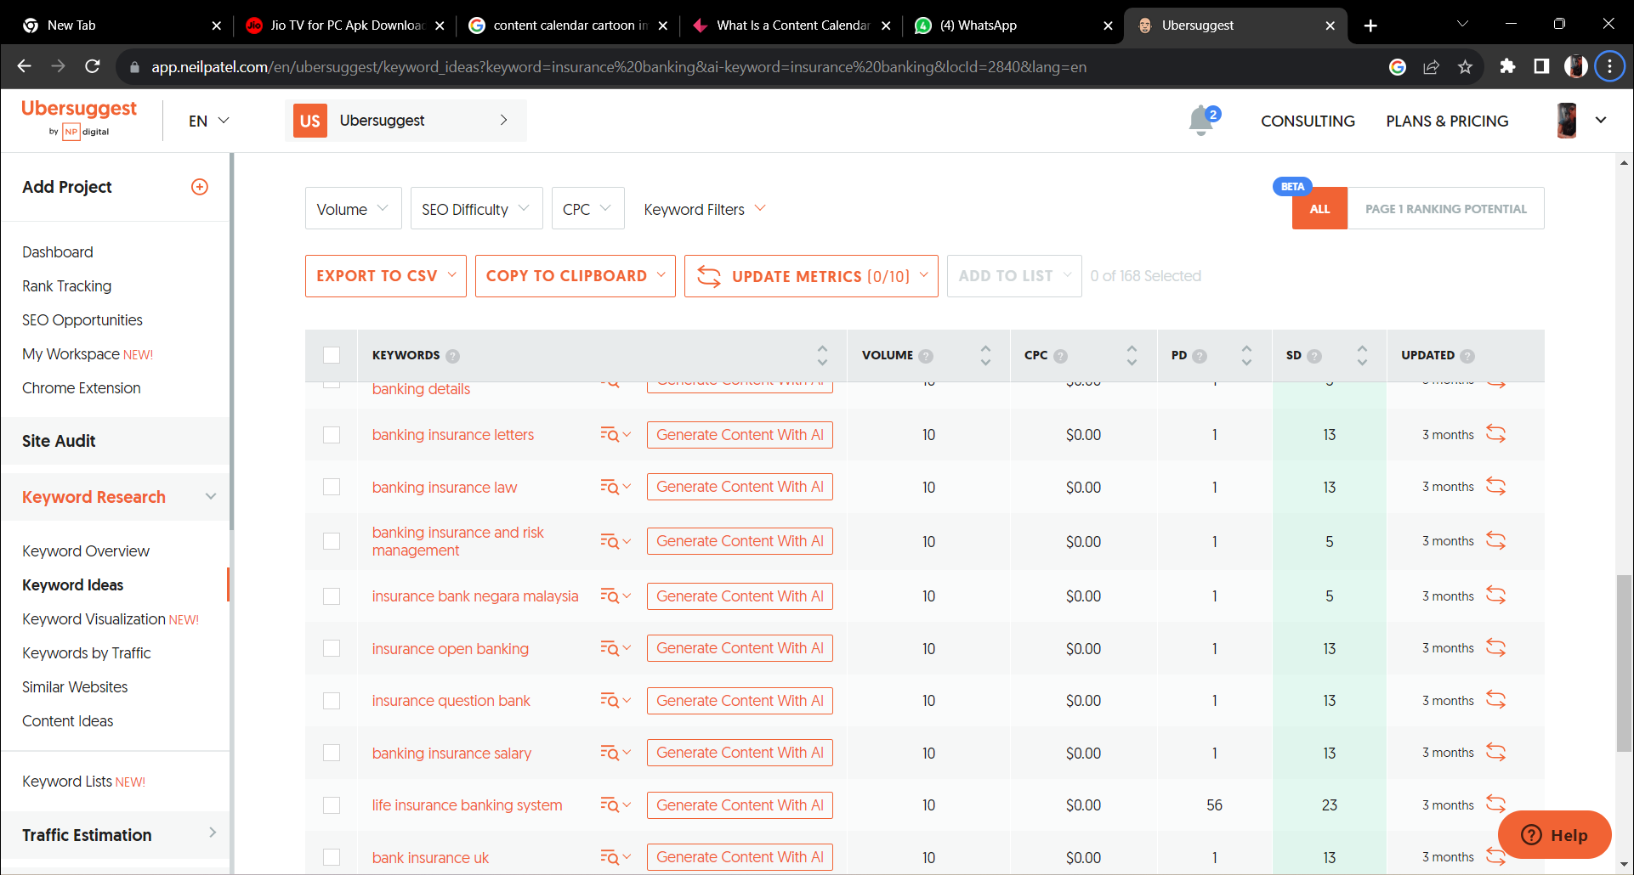

Slide 20
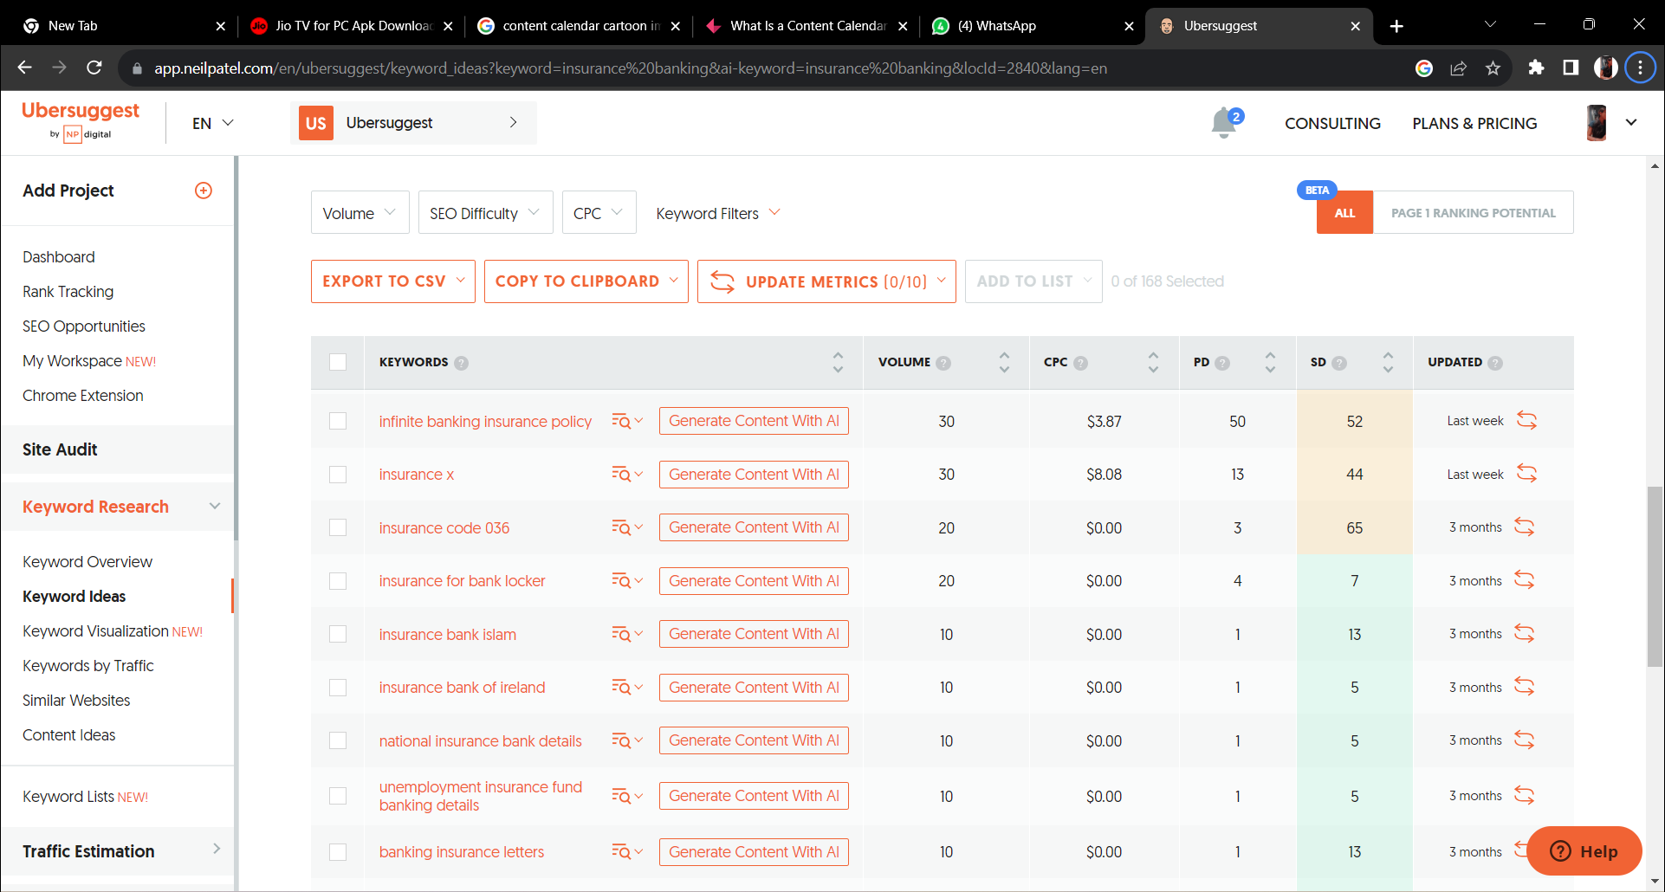

Slide 21
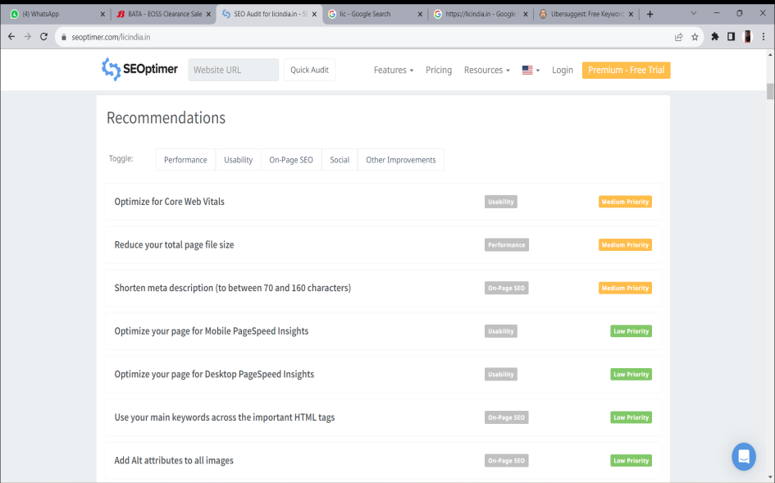
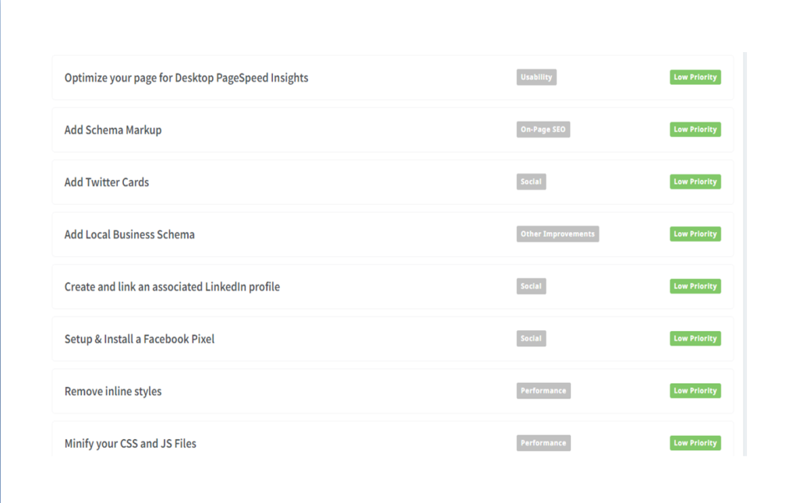
C. SEO OPTIMIZATION
Website: https://www.seoptimer.com/fr

Slide 22
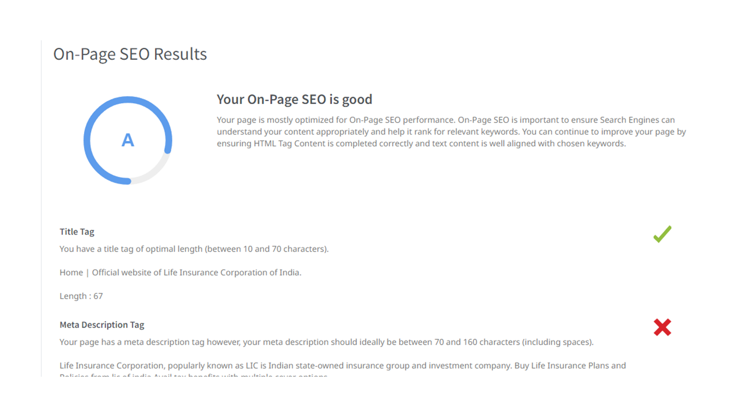
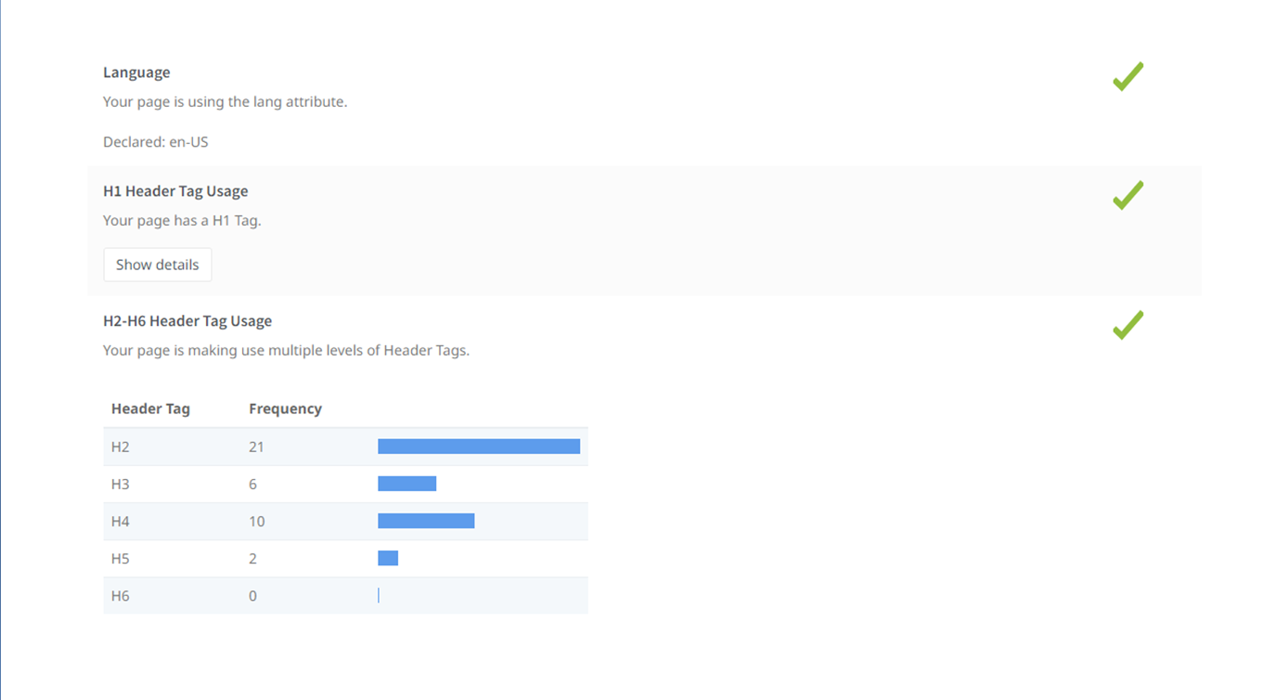

Slide 23
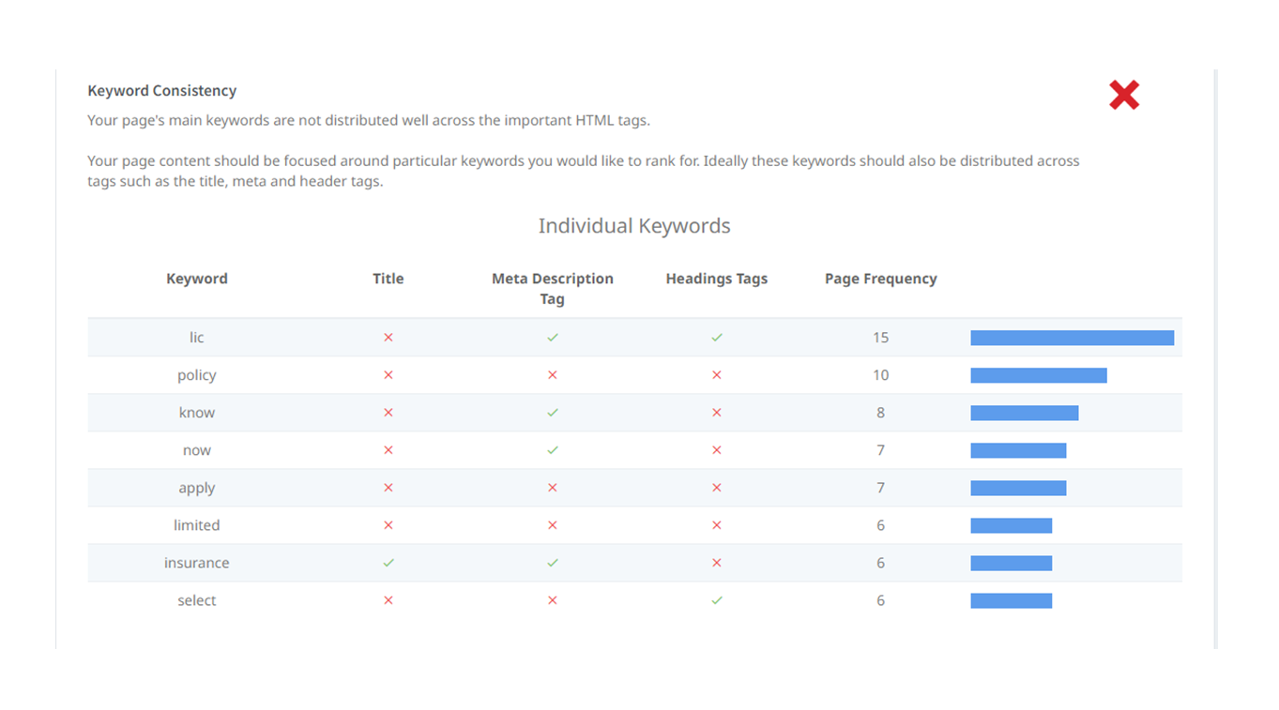
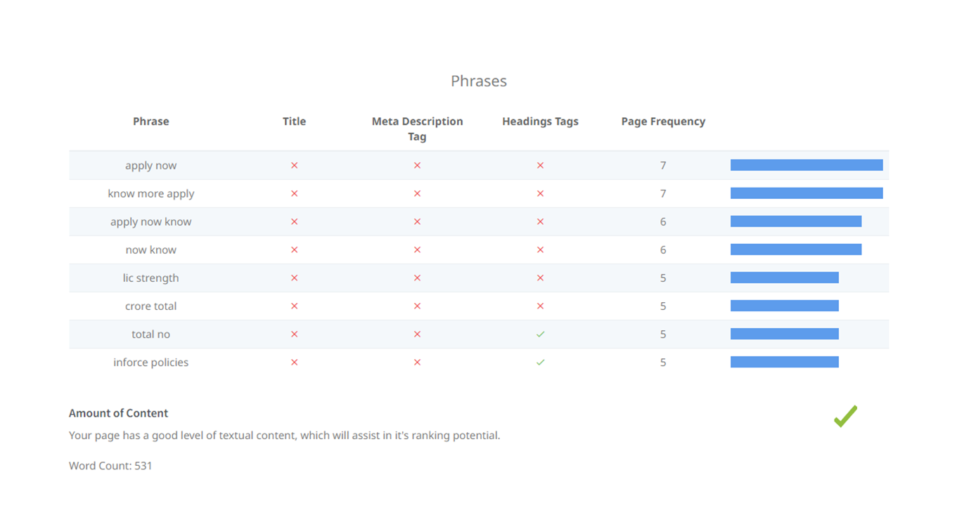

Slide 24
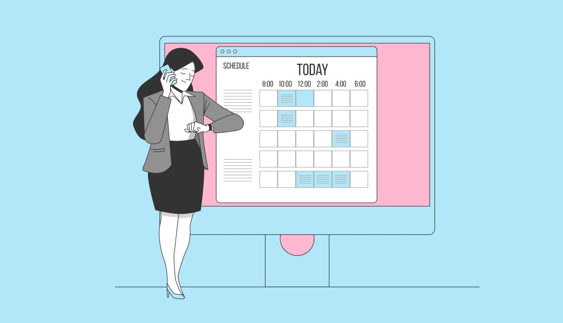
Part 3: Content Ideas and Marketing Strategies
Content Idea Generation & Strategy: Create a content calendar for the remaining month of July by brainstorming content themes, exploring various formats like blog posts, videos, Infographics, podcasts, and interactive quizzes, and scheduling publication dates mainly on Facebook & Instagram.
And include the strategy, aim and the idea behind these posts and story
Content Calendar Example (Try creating a table for the month of August)

Slide 25
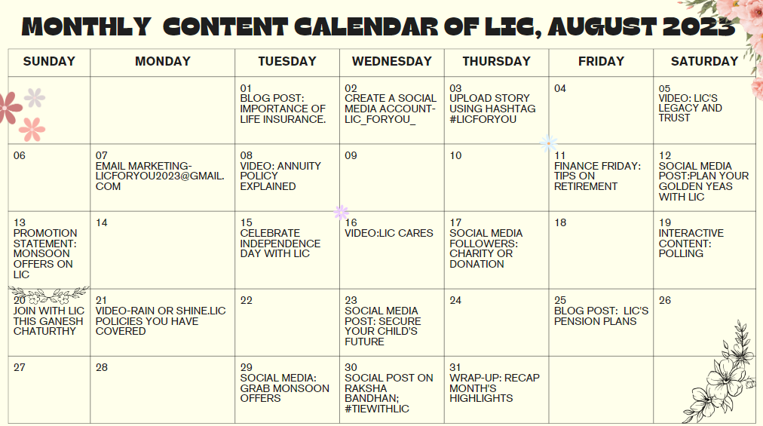

Slide 26
Part 4: Content Creation and Curation (Post creations, Designs/video Editing, Ad campaigns over social Media and Email Ideation and creation)
Post Creation:
Select Content Categories: Identify three different content formats relevant to the chosen topic or industry. Research and Brainstorm: Research trending topics, industry news, or audience interests within each category. Brainstorm ideas for social media posts that align with each category. Do note that 1 content format has to be video and additionally 3 stories/status are to be created.
Format 1 : Instagram Story
Format 2 : Designs/Video Editing
Format 3 : Social Media Ad Campaigns

Slide 27
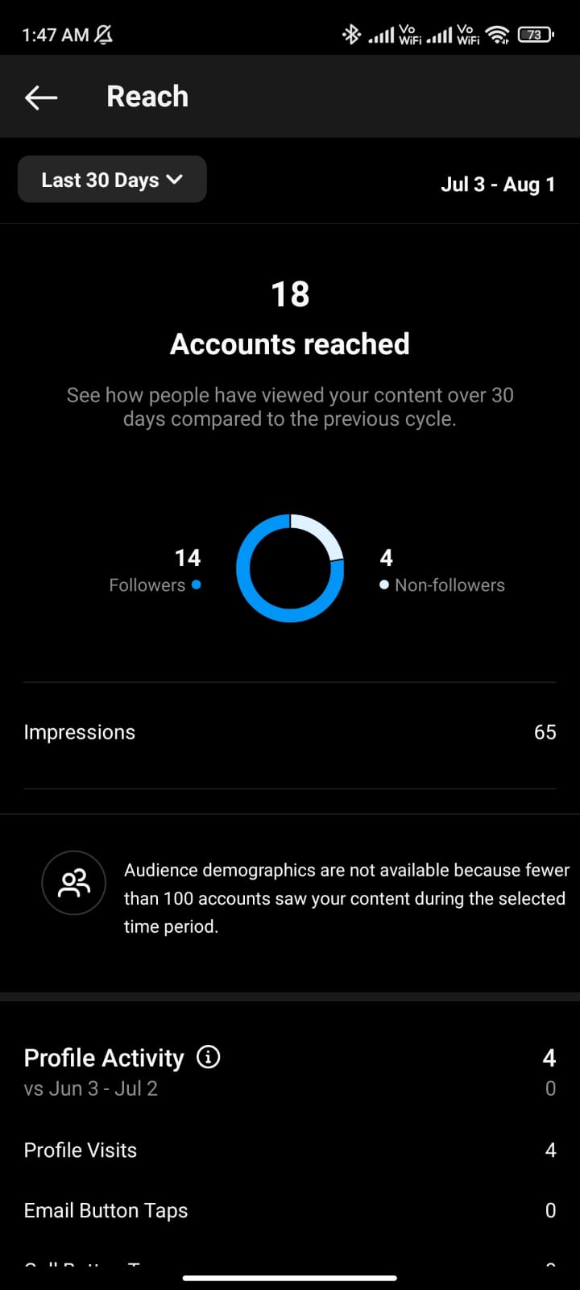
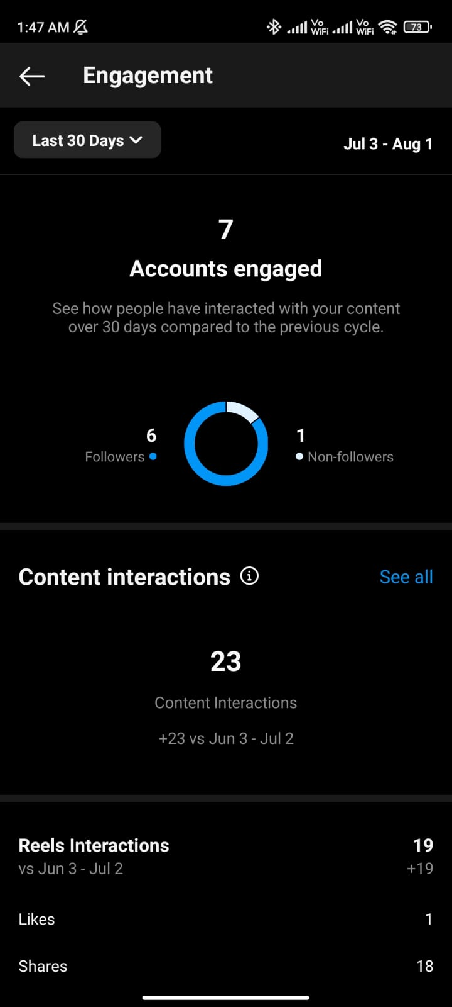
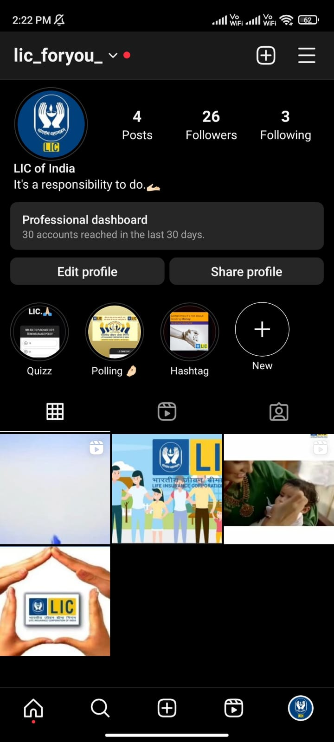
Part 4: Content Creation and Curation (Post creations, Designs/video Editing, Ad campaigns over social Media and Email Ideation and creation)
Account Reached
Account engaged
Instagram Page

Slide 28
Part 4: Content Creation and Curation (Post creations, Designs/video Editing, Ad campaigns over social Media and Email Ideation and creation)
FORMAT 1: Instagram story and post creation
Aim: To enhance customer relationship.
Idea: To increase the customer interaction and feedback support.
Link: click here
Significance of Instagram story and post creation:
Helps in Engagement:
Generally, social media is proven to be the best platform for maintaining relationships with customers.
Strengthening of Brand:
Instagram marketing has helped magically for brand awareness. This social network has helped users to discover new services and products.
Helps in Sales Enlargement:
We all know that purchasing made by the Instagram audience is willing. There is a gigantic buying audience.
Growth Opportunity of Audience:
Instagram helps in increasing our business’s reach by helping in defining the target audience.

Slide 29
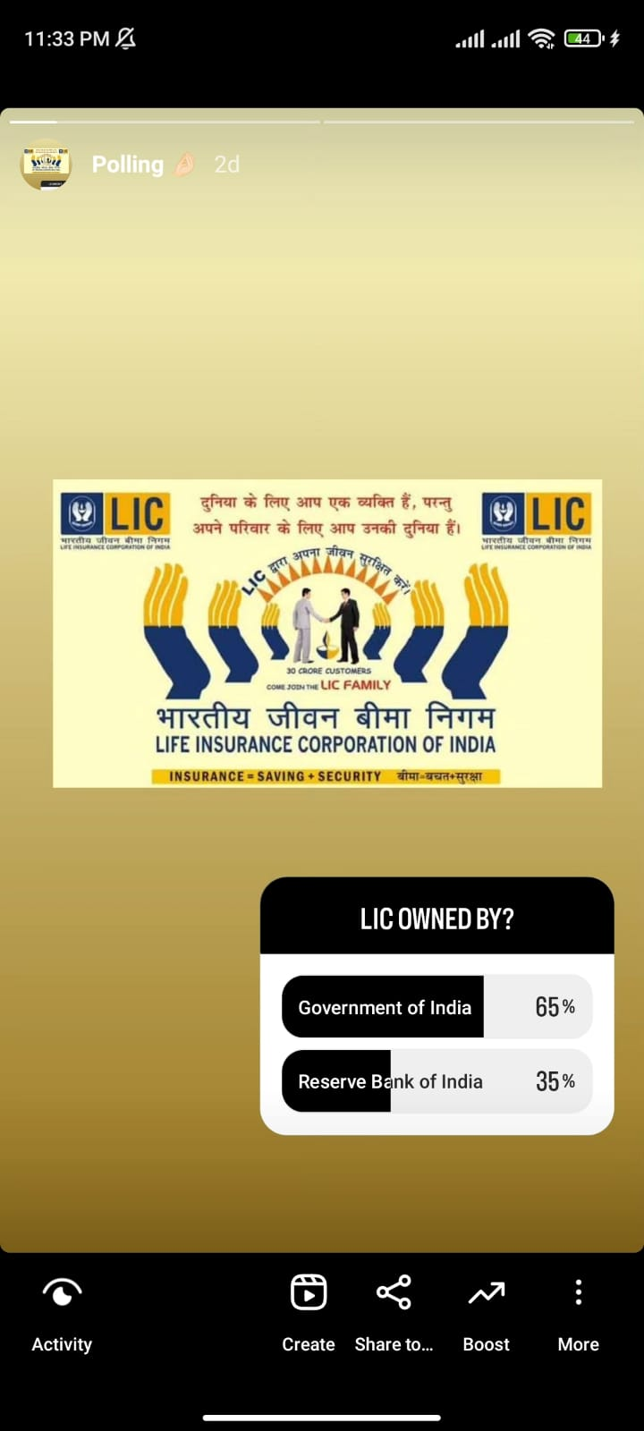
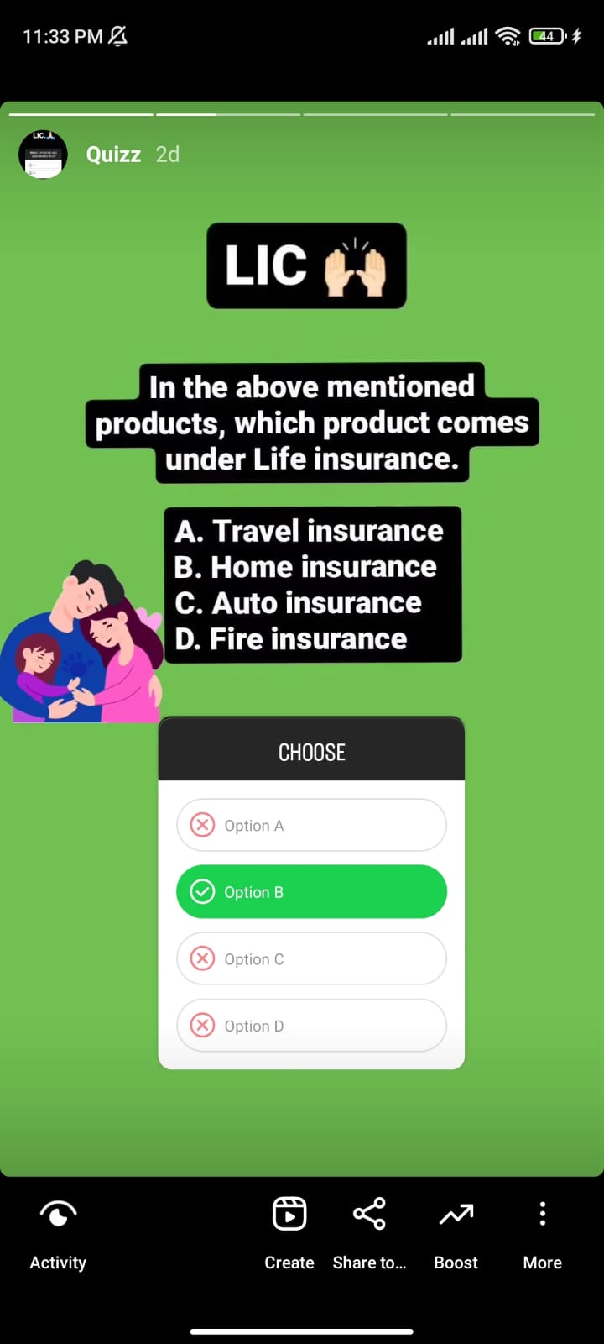
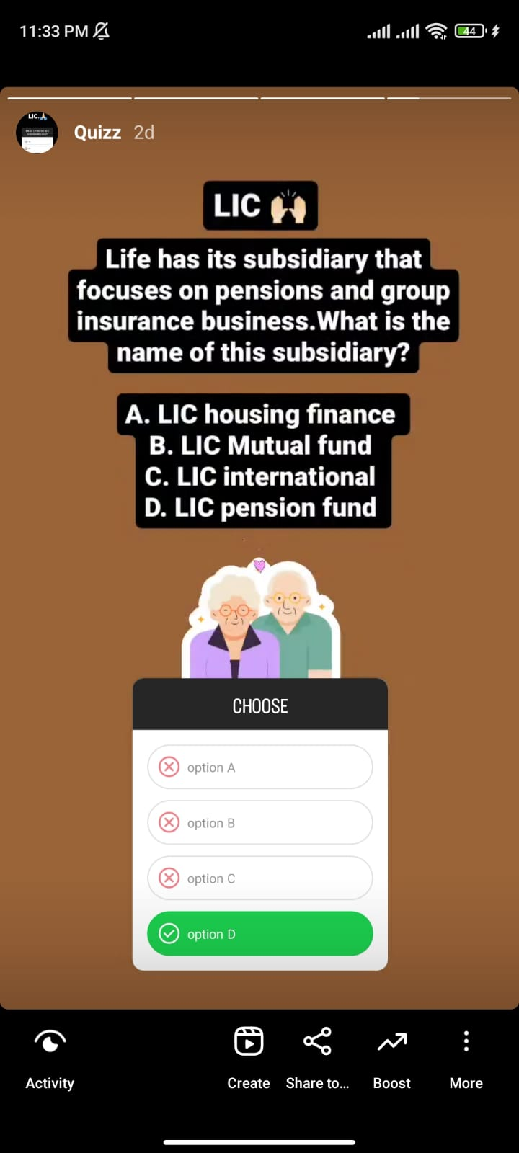
INSTAGRAM STORIES
POLLING
QUIZ
QUIZ

Slide 30
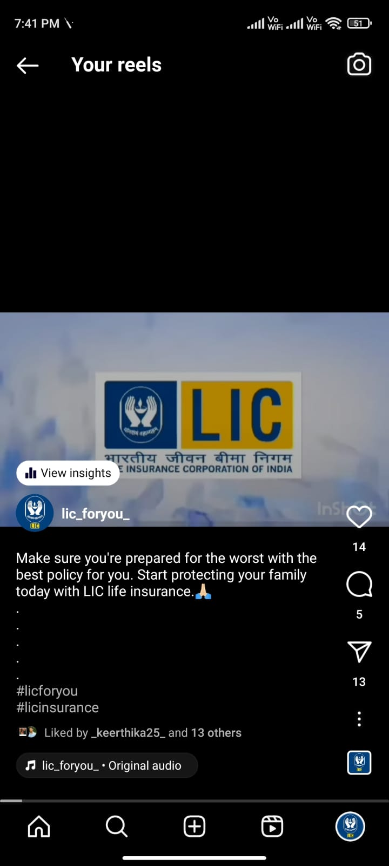
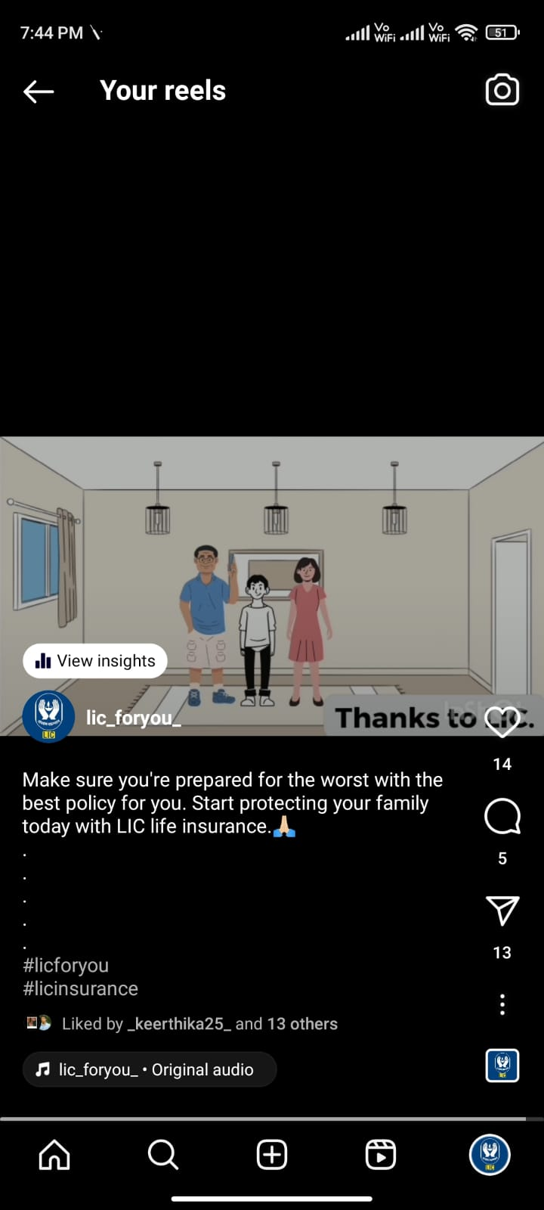
Part 4: Content Creation and Curation (Post creations, Designs/video Editing, Ad campaigns over social Media and Email Ideation and creation)
Format 2: Design and Video Editing
Aim: To enhance LIC brand image and value.
Date: 2nd August 2023
Idea: We have created an imaginary situation in a small family showcasing the importance of LIC Insurance.
Topic: Presenting the need of LIC insurance.
Link: Click for Instagram video
Drive link: Click here
Caption: Make sure you’re prepared for the worst with the best policy for you. Start protecting your family today with LIC life insurance. 🙏

Slide 31
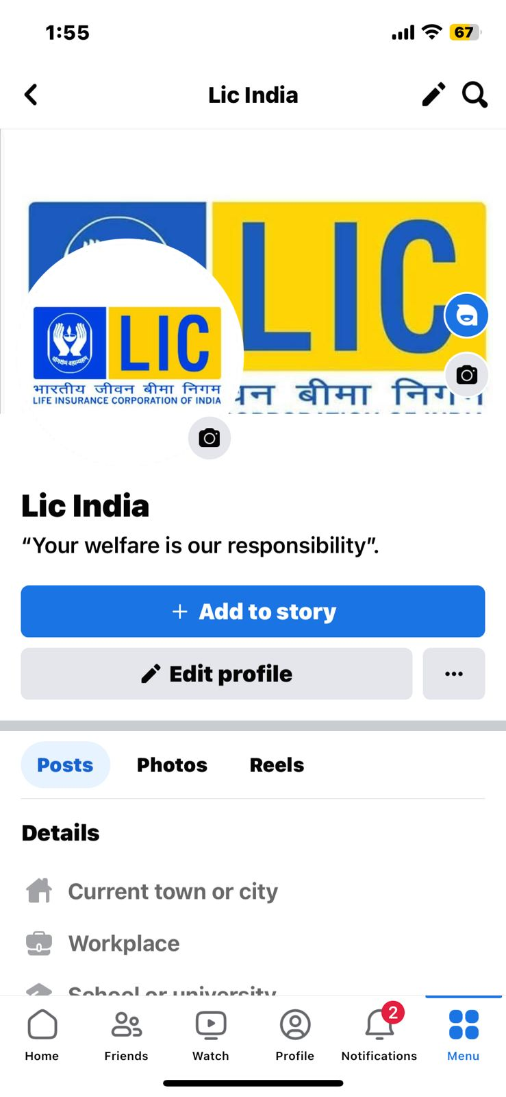
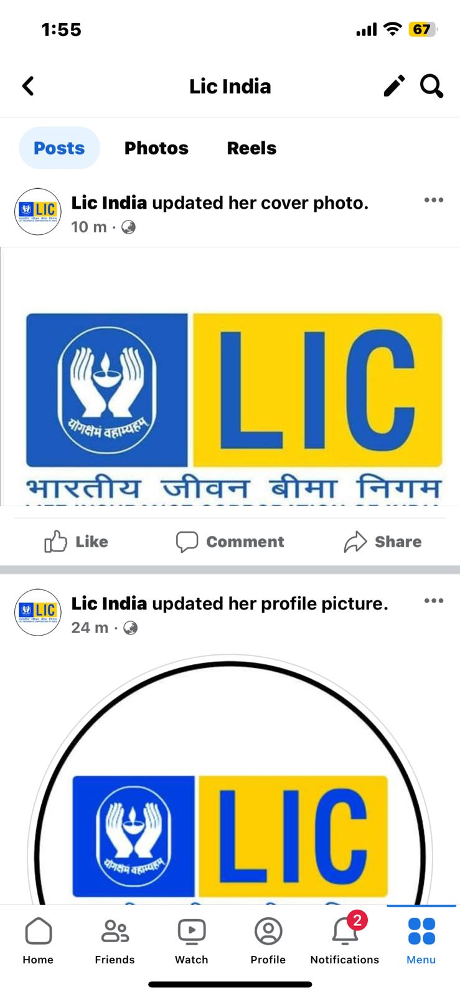
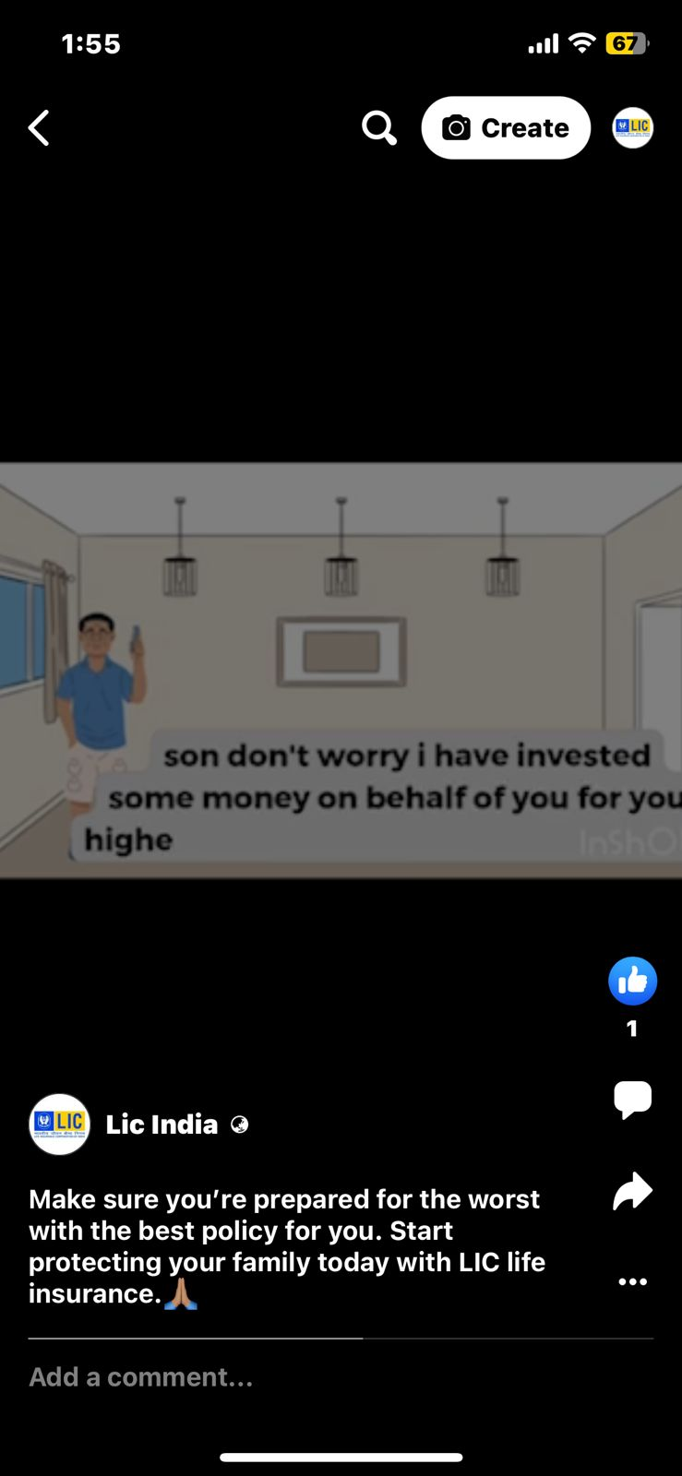
Part 4: Content Creation and Curation (Post creations, Designs/video Editing, Ad campaigns over social Media and Email Ideation and creation)
Format 3: Facebook Ad Campaign

Slide 32
Part 4: Content Creation and Curation (Post creations, Designs/video Editing, Ad campaigns over social Media and Email Ideation and creation)
OBJECTIVES OF FACEBOOK AD CAMPAIGN:
Establish a Facebook presence.
•Engage the audience.
•Drive traffic to the website.
•Foster interaction and trust.
•Use Facebook ads strategically.
•Analyze performance and optimize.
Link of Facebook Page: click here

Slide 33
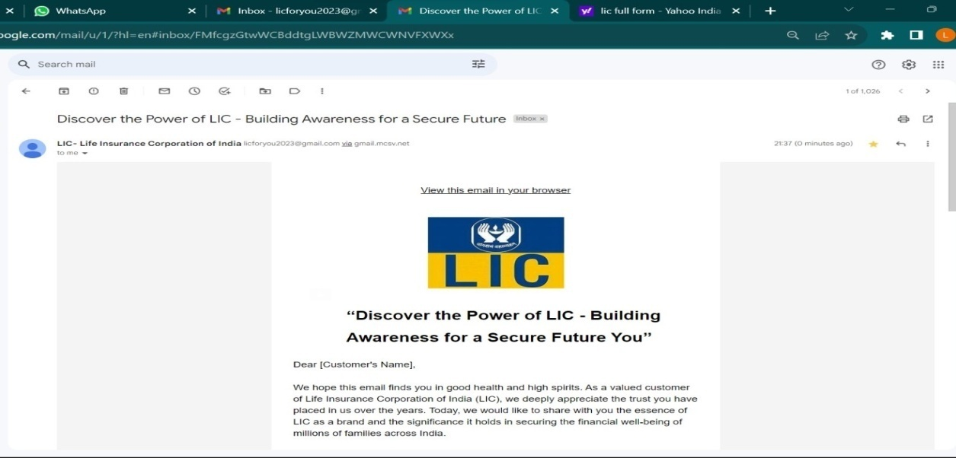
Part 4: Content Creation and Curation (Post creations, Designs/video Editing, Ad campaigns over social Media and Email Ideation and creation)
Email Ad Campaigns:
We created two email campaigns were created by using the website Mailchimp via internet. One email is created for the purpose of Brand awareness and the other one for Lead generation of LIC Insurance company. These campaign mails were sent via Gmail.
EMAIL AD CAMPAIGN-1
BRAND AWARNESS:

Slide 34
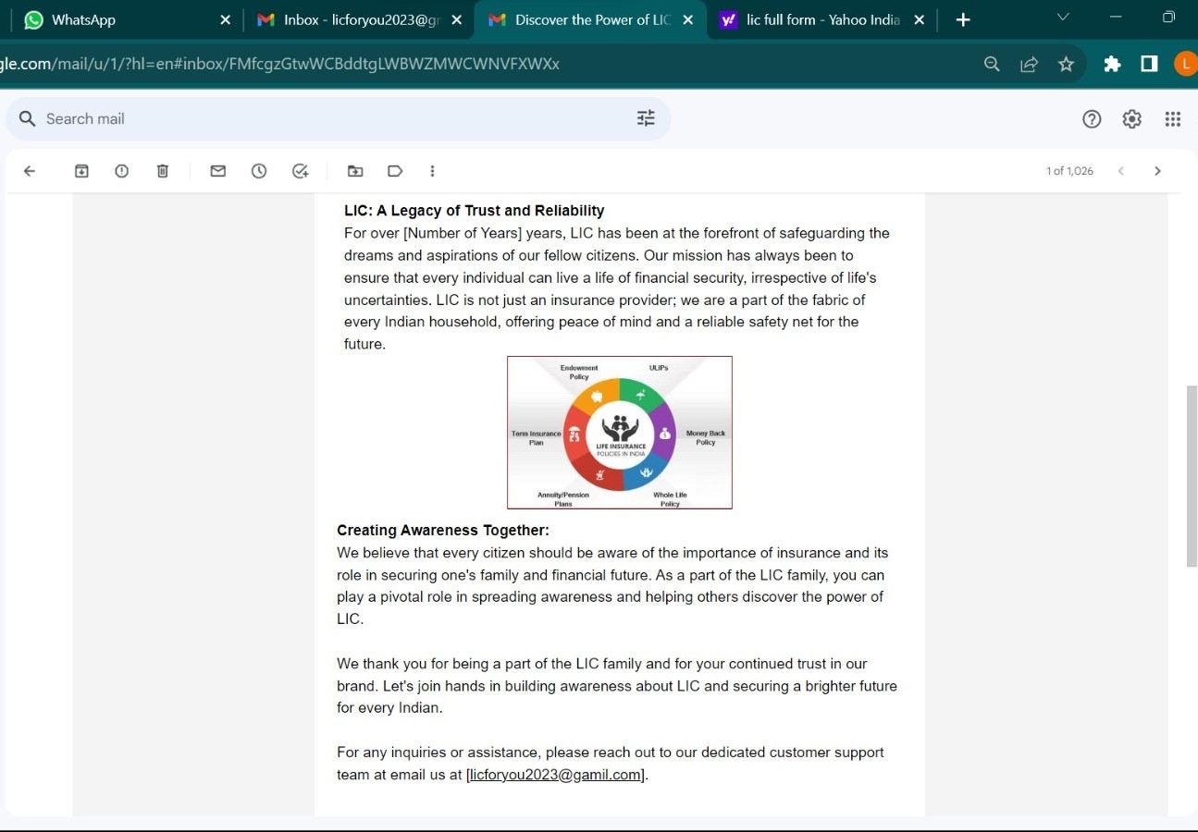
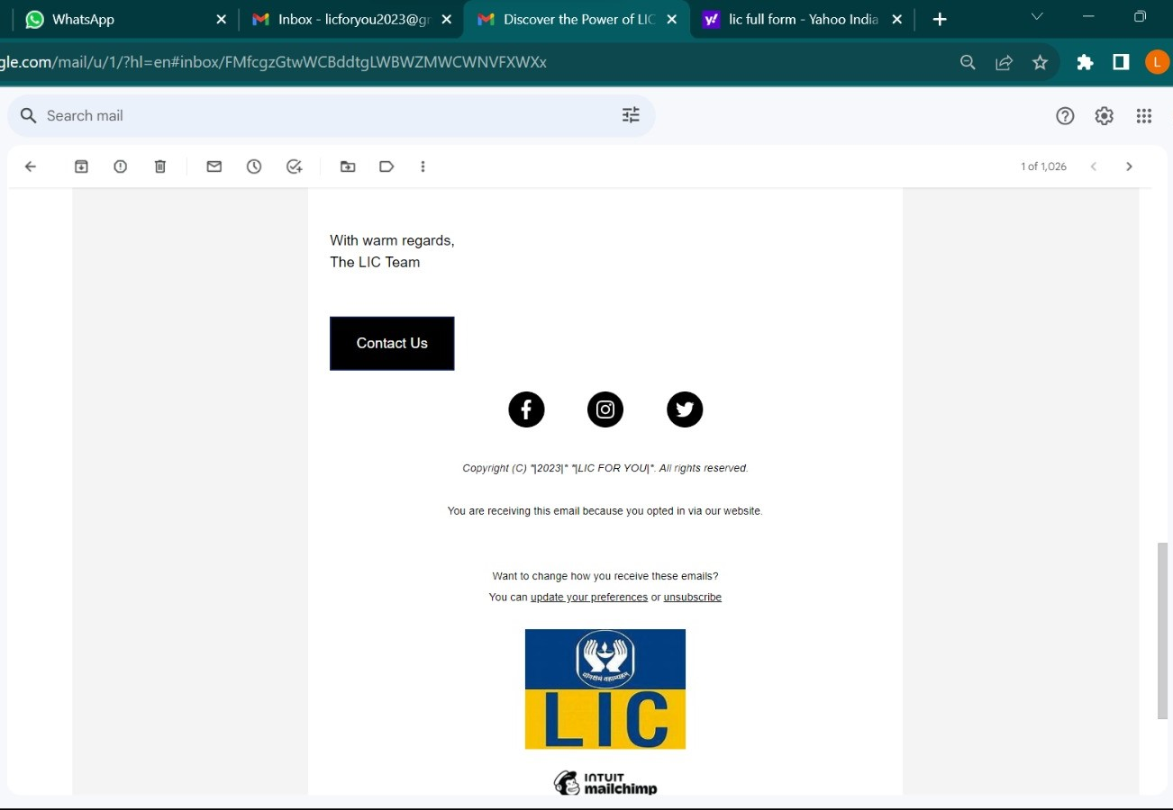

Slide 35
This was the first mail which we have created using Mailchimp website for email Ad campaign purpose. The previous slide highlights the importance of LIC life insurance and we wanted to create Brand awareness and Brand endorsement through the email. We have also mentioned the social media platform such as Instagram and face book through the Brand awareness email campaign.
Instagram: Click here
Face book: Click here
EMAIL AD CAMPAIGN-2
LEAD GENERATION: This was the second email which me and my team creatd using Mailchimp website again. The main purpose of creating this email is for Lead generation.

Slide 36
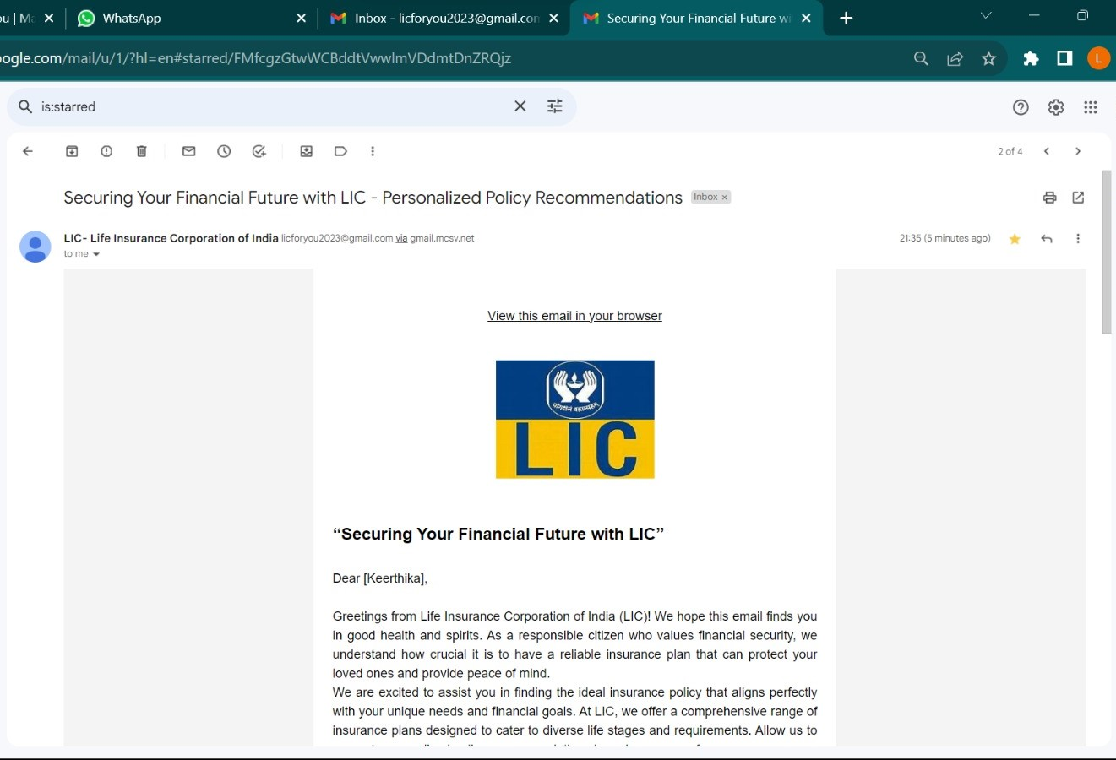
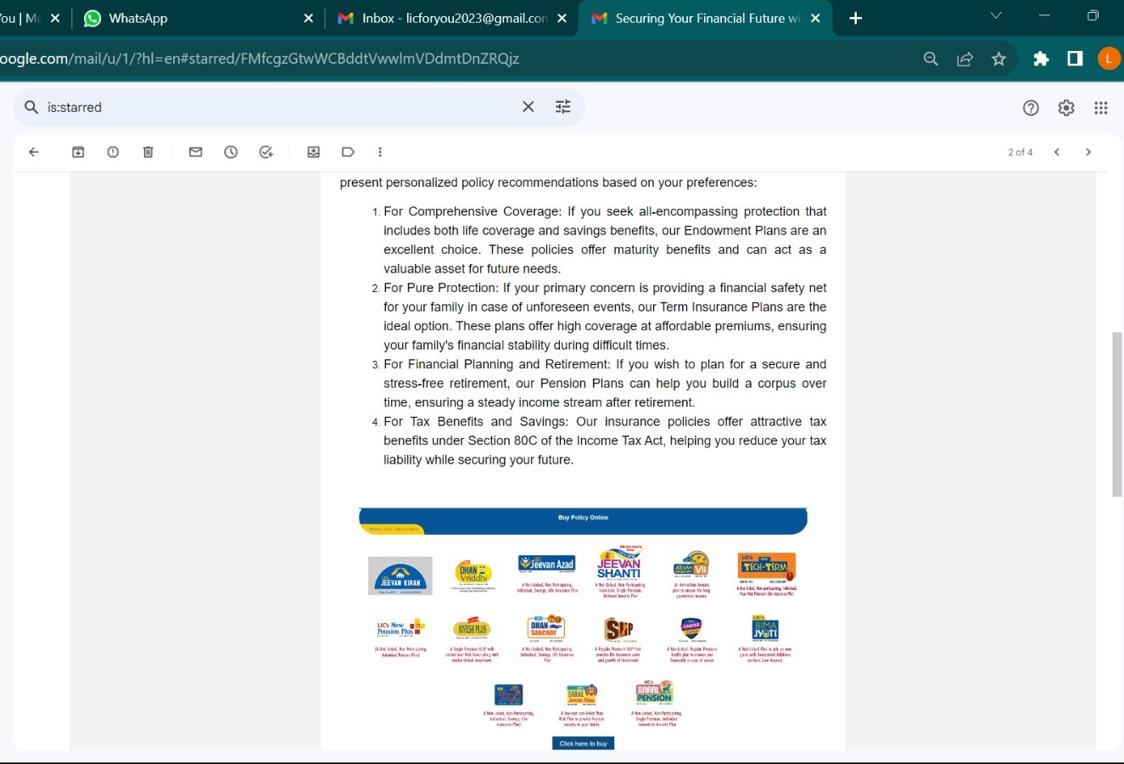

Slide 37
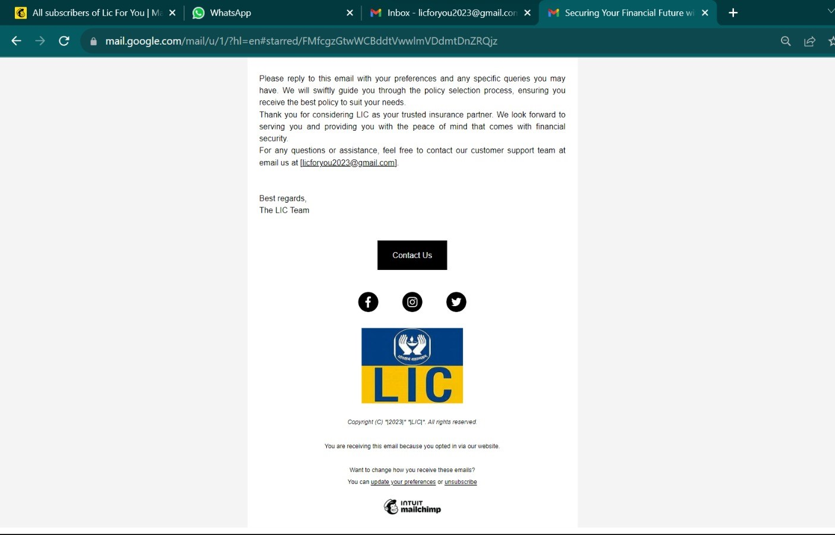
The main ideal purpose of the above Lead generation email Ad campaign is to reach large scale of audience and capture their interest.
Through this method of email ad campaign, we were able to tap large number of customers and it was considered to be cost effective and flexible.

Slide 38
Part 4: Content Creation and Curation (Post creations, Designs/video Editing, Ad campaigns over social Media and Email Ideation and creation)
Lessons learned:
Understanding the target audience and their needs.
Utilizing digital channels and gaining knowledge of various digital marketing channels.
Creating informative and engaging content.
Analysing data and Metrics.
Challenges faced:
Dealing with strict regulations and guidelines of different websites.
The digital marketing landscape is constantly changing, with trends, algorithms and technologies emerging.
Limited access to the websites as it is not available for free after first sign up.
Promotional ideas for the given topic was a challenging task to achieve.

Slide 39
THANK YOU

